Slide 1
Zero copy cloning
How does Zero Copying cloning work in Snowflake?
-Zero copy cloning is a feature in Snowflake that allows you to create a copy of any table, schema, or database without copying the actual data or adding any storage costs
Technical details and underlying mechanisms
-when a clone is created, Snowflake generates new metadata for the clone that points to the same underlying micro-partitions as the original object. This means that the cloned object shares the data blocks with, and no additional storage is consumed at the time of the cloning.
Use Cases for Zero Copy Cloning:
Testing: Clone production data to a test environment to validate changes without affecting live operations.
Development: Allow multiple developers to work with a consistent dataset without stepping on each other's toes.
Data sharing: share datasets with different departments or external partners without risking data modification
Backup and Recovery: Quickly create a clone for backup purposes; revert to it if necessary
Reporting: Generate real-time reports from cloned data without impacting performance of the primary dataset.
These are advantagous because the clone utilizes no additional data storage, but you can still, add, delete and update clone independently from the original table. This can be quite useful for quickly producing backups that don’t cost anything extra until the copied object is changed.

Slide 2
More on cloning and then COPY INTO
Pros:
Almost no additional storage costs for cloning data
No waiting time for cloning data from one environment to another
No need for administrative efforts, as cloning is as simple as a Select
Cons:
Increased Memory Usage
Security Risks
Complexity when it comes to implementing it
Moving on to Copy into and how the command work?
The copy into command works by loading data from staged files to an existing tables. The files must already be staged in one of the follwing locations: internal stage(user stage/ or table), external stage(cloud storage snowflake supports)

Slide 3
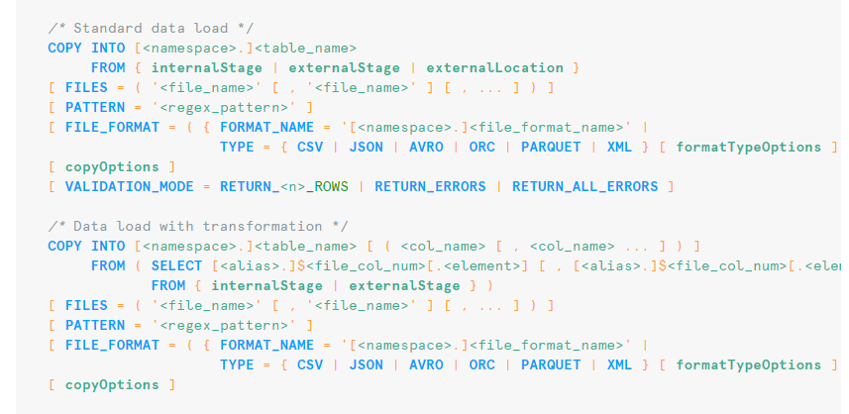
Syntax and common parameters when using copy into

Slide 4
More on Copy Into
Use Cases for copy into:
- Loading Large datasets
Handling different file formats
High Volume Transactions
Examples and benefits:
A financial institution wants to analyze transactional data stored in CSV files hosted on AWS S3. The data includes transaction amounts, dates, and customer IDs.
Benefits: Directly loading data from S3 simplifies the process of updating the dataset frequently. The CSV format is straightforward, and Snowflake handles the conversion of text to numeric types automatically.
Comparison with INSERT INTO:
COPY INTO is optimized for bulk data loading from external sources, offering high performance and scalability for large datasets. On the other hand, INSERT INTO is more flexible and suitable for scenarios where data manipulation or control over the insertion process is required, or when the data originates from within Snowflake.

Slide 5
Pros and cons of copy into
Pros:
High Performance
Direct Loading from External Sources
Support for Various File Formats
Cons:
Complexity in Setup
Limited Error Handling
Dependency on External Services

Slide 6
3. Time Travel
Understanding Time Travel
Automatically enables access to historical data that has been changed or deleted within a specified time period (standard is 1 day, but can be set to 90 days)
Snapshots of data before every update that is available for the data retention period
CREATE OR REPLACE DATABASE my_db DATA_RETENTION_TIME_IN_DAYS = 30
Use Cases
Data Recovery: restore objects that were accidentally dropped/deleted (UNDROP Table/Schema)
Auditing Changes: allows users to track changes
Clone Objects: create clone of table/schema/DB as they existed before updated
CREATE CLONE my_table_clone OF my_table AT/BEFORE (TIMESTAMP =>…)
Query Historical Data: retrieve state of tables at specified timestamp
SELECT * FROM my_table AT/BEFORE (TIMESTAMP => '2023-01-01T00:00:00’)
Pros
Ability to recover data, pinpoint problems during debugging, version history with cloning
Cons
Storage costs, potential data privacy invasion, slow query performance when accessing historical data, doesn’t work on transient table

Slide 7
4. Streams and Tasks
Understanding Streams
Snapshot of table by initializing an offset (point in time) as current version
Object that records data manipulation language (DML) changes made to tables(inserts, updates, and deletes) & metadata about each change → process called change data capture (CDC)
3 Types: Standard, Append, Insert-Only
CREATE OR REPLACE STREAM x ON TABLE Y;
Understanding Tasks
use user defined functions to automate/schedule queries
Can put multiple tasks together using task graphs to create data pipelines
Ex: root task → update customer, product, date tbl simultaneously → then combine to new table
Can be manually executed or put on a schedule (CREATE TASK, SCHEDULE TASK, EXECUTE TASK)
Use Cases
Can combine a table stream with a task (triggered task) to enable continuous ETL to process recently changed data
Use streams when you want to detect patterns for temporal events
Use tasks to orchestrate administrative jobs (backups/ quality checks)
Pros
Stream: ability to query/access changed data in a consistent manner (data accuracy)
Tasks: schedule execution of SQL commands
Cons
Stream: can grow rapidly and consume lots of resources, can lag behind source objects, may not capture all changes for some data types (semi-structured/ geospatial)
Table schema evolution not supported

Slide 8
5. Data Masking & Row Access Policies
Row Access Policies: row-level security feature that determine whether a given row or table can be accessed in SELECT, UPDATE, DELETE, or MERGE statements based on a user's role
Data Masking: column-level security feature that selectively masks plain-text data in table and views columns at query time
Implementation Strategy:
CREATE OR REPLACE ROW ACCESS POLICY | CREATE OR REPLACE MASKING POLICY
Use Cases:
Column Masking can be used to hide PII columns to prevent data leaks/protect data integrity
Row Access Policies allow multiple users access to a centralized data source, but will only give them access to rows they need access to (also maintains data integrity) (tenant example)
Hiding private rows and columns can reduce the amount of data available to a data engineer, which can make for easier querying/analysis/processing of a database
Pros:
Increases data integrity and protects user's privacy when dealing with PII
Reduces clutter in dataset for data teams
Saves time since new, personalized views of original data no longer need to be made
Cons:
Additional cost is associated with adding more security features
Query time may increase when considering the addition of data masking and/or row access policies

Slide 9
6. UDF (User-Defined Functions) and Stored Procedures
UDF: helper function that is designed by the user to return an output row or a tabular value for each input row of a parameter table (only input parameters)
Stored Procedures: contains logic that typically performs database operations by executing SQL statements on an input table (can contain input/output parameters)
Implementation Strategy:
CREATE OR REPLACE FUNCTION addone(i int) | CREATE OR REPLACE PROCEDURE
Use Cases:
Stored Procedures can be used to automate table deletion, clean up unused tables, or load information from a stage (S3 processing of CSV, JSON, and Parquet)
Functions are great for performing complex calculations such as a user's city based on IP address and calculating order discounts based on numerous parameters (age, how long someone's been a customer, location, etc.)
Pros:
Pre-defined functions can reduce code redundancy and speed up data processing/transformation
Allows for the incorporation of supported languages including Java, Python, Scala, and JavaScript
Cons:
Functions have limited error handling, can't use temporary tables, and can't call stored procedures
Stored Procedures can't be accessed on an in-line SQL statement

